Slide 1

Formal verification of TLS in the secure socket api
Presented matthew christensen March 5, 2022

Slide 2
Formal Verification
“Program testing can be used to show the presence of bugs, but never to show their absence!”
-Edsger W. Dijkstra

Slide 3


Slide 4

The secure socket api
Internet Research Lab
Using TLS is hard
Symbols in libssl: 504
Lines of code: 317
int socket = socket(PF_INET, SOCK_STREAM, IPPROTO_TCP);
int socket = socket(PF_INET, SOCK_STREAM, IPPROTO_TLS);
Notes:
Transfer of trust to library IPPROTO_TLS rather than relying on the developer to make the app secure

Slide 5
The problem
How do we know the Secure Socket API actually makes your socket secure?

Slide 6
Formal verification process
Properties
Contracts
Model
Verification
Determine what properties are required for a secure connection.
Determine what is required to guarantee secure properties.
Model codebase in Dafny and overlay contracts onto model.
Verify that the model represents the codebase accurately.

Slide 7



Weakest Precondition Calculus
Problem: how to prove quality F?
Function 1
Function 2
Function 3
Function 4
Function 5
Requires A
Ensures B
Requires B
Requires D
Ensures C
Requires C
Ensures D
Ensures E
Requires E
Ensures F
Thus, given A we can prove F

Slide 8
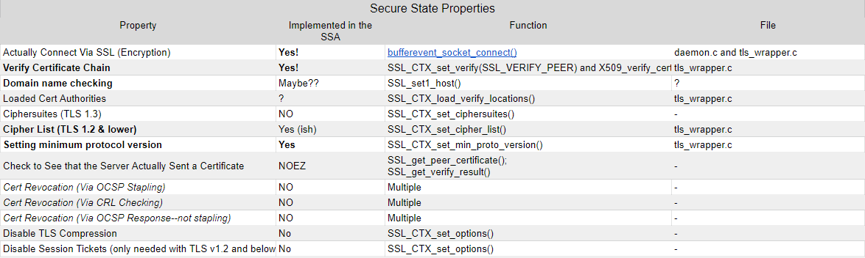
Concrete Example

Slide 9
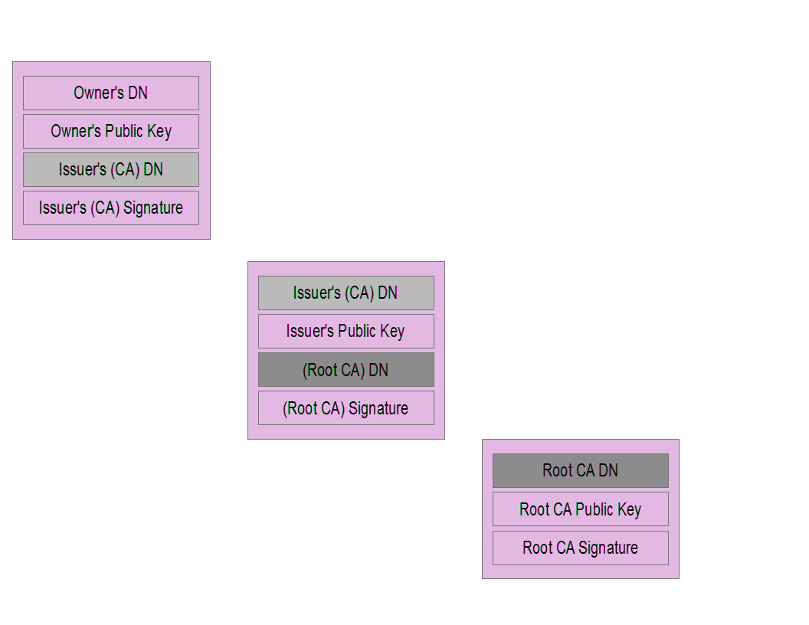
Certificate Chain

Slide 10
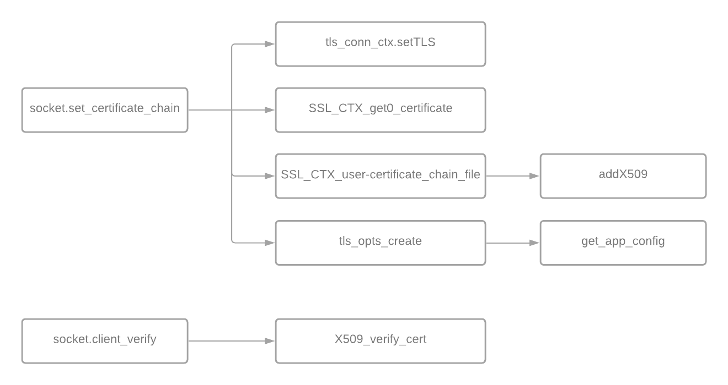

Slide 11
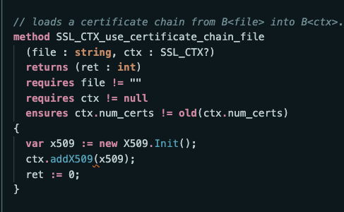
Place your screenshot here
Notes:
This slide shows an example of the high level concept explained in the previous slide

Slide 12
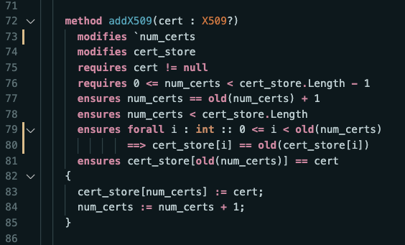
Place your screenshot here
Notes:
This slide and the next shows an example of the high level concept explained in the previous slide

Slide 13
Conclusion and What is next?
The Secure Socket API is an effective way of guaranteeing a secure TLS connection (as far as it has been implemented validated)
Formal verification of meaningful (non-trivial) code is hard
We lack formal verification that our model represents the codebase
Solution: Integrate proof into the codebase
We need more general tools for formal verification

Slide 14
thanks!
Any questions?

